Slide 1


Groovy
Brief Introduction
by Vadim Bromberg
brvadim@opentunities.com
September 2011

Slide 2
Who am I
Computer Engineer with more than 15 years experience
Have more then 12 years experience with Java JEE development and worked with different script languages and web frameworks
Last 7 years is used as Project Manager for Enterprise web application and complicated Integration projects

Slide 3
Agenda
What is Groovy: power in your code
What Groovy can do for you as Java professional, script programmer or pragmatic agilist
Groovy in glance
  Main features
  Data types
  Examples

Slide 4
What is Groovy
“Groovy is an agile, dynamic programming language for the Java Virtual Machine. Groovy includes features found in Python, Ruby, and Smalltalk, but uses syntax similar to the Java programming language."¹
¹From Java Specification Request web page http://www.jcp.org/en/jsr/detail?id=241

Slide 5
Java to Groovy
import java.util.List;
import java.util.ArrayList;
class JavaToGroovy {
private List<String> filterLongerThan(List<String> strings, int length) {
List<String> result = new ArrayList<String>();
for (String s: strings) {
if (s.length() <= length) {
result.add(s);
}
}
return result;
}
public static void main(String[] args) {
List<String> names = new ArrayList<String>();
names.add("Ted");
names.add("Fred");
names.add("Jed");
names.add("Ned");
System.out.println(names);
JavaToGroovy e = new JavaToGroovy();
List<String> shortNames = e.filterLongerThan(names, 3);
System.out.println(shortNames.size());
for (String s: shortNames) {
System.out.println(s);
}
}
}

Slide 6
Java to Groovy
Default core
Imports
import java.util.List;
import java.util.ArrayList;
class JavaToGroovy {
private List<String> filterLongerThan(List<String> strings, int length) {
List<String> result = new ArrayList<String>();
for (String s: strings) {
if (s.length() <= length) {
result.add(s);
}
}
return result;
}
public static void main(String[] args) {
List<String> names = new ArrayList<String>();
names.add("Ted");
names.add("Fred");
names.add("Jed");
names.add("Ned");
System.out.println(names);
JavaToGroovy e = new JavaToGroovy();
List<String> shortNames = e.filterLongerThan(names, 3);
System.out.println(shortNames.size());
for (String s: shortNames) {
System.out.println(s);
}
}
}
Optional
semicolons
Alternate for
each syntax

Slide 7
Java to Groovy (Take 2)
class JavaToGroovy {
private List<String> filterLongerThan(List<String> strings, int length) {
List<String> result = new ArrayList<String>()
for (String s: strings) {
if (s.length() <= length) {
result.add(s)
}
}
return result
}
public static void main(String[] args) {
List<String> names = new ArrayList<String>()
names.add("Ted")
names.add("Fred")
names.add("Jed")
names.add("Ned")
System.out.println(names)
JavaToGroovy e = new JavaToGroovy()
List<String> shortNames = e.filterLongerThan(names, 3)
System.out.println(shortNames.size())
for (s in shortNames) {
System.out.println(s)
}
}
}

Slide 8
Java to Groovy (Take 2)
class JavaToGroovy {
private List<String> filterLongerThan(List<String> strings, int length) {
List<String> result = new ArrayList<String>()
for (String s: strings) {
if (s.length() <= length) {
result.add(s)
}
}
return result
}
public static void main(String[] args) {
List<String> names = new ArrayList<String>()
names.add("Ted")
names.add("Fred")
names.add("Jed")
names.add("Ned")
System.out.println(names)
JavaToGroovy e = new JavaToGroovy()
List<String> shortNames = e.filterLongerThan(names, 3)
System.out.println(shortNames.size())
for (s in shortNames) {
System.out.println(s)
}
}
}
Dynamic
Types
No class
declaration
or main

Slide 9
Java to Groovy (Take 3)
def filterLongerThan(strings, length) {
List<String> result = new ArrayList<String>()
for (String s: strings) {
if (s.length() <= length) {
result.add(s)
}
}
return result
}
List names = new ArrayList()
names.add("Ted")
names.add("Fred")
names.add("Jed")
names.add("Ned")
System.out.println(names)
def shortNames = e.filterLongerThan(names, 3)
System.out.println(shortNames.size())
for (s in shortNames) {
System.out.println(s)
}

Slide 10
Java to Groovy (Take 3)
def filterLongerThan(strings, length) {
List<String> result = new ArrayList<String>()
for (String s: strings) {
if (s.length() <= length) {
result.add(s)
}
}
return result
}
List names = new ArrayList()
names.add("Ted")
names.add("Fred")
names.add("Jed")
names.add("Ned")
System.out.println(names)
def shortNames = e.filterLongerThan(names, 3)
System.out.println(shortNames.size())
for (s in shortNames) {
System.out.println(s)
}
Special List
Notation
List Finder
Syntax
List Processing
Syntax

Slide 11
Java to Groovy (Take 4)
def filterLongerThan(strings, length) {
return strings.findAll { it.size() <= length }
}
def names = ["Ted", "Fred", "Jed", "Ned"]
System.out.println(names)
def shortNames = e.filterLongerThan(names, 3)
System.out.println(shortNames.size())
shortNames.each {
System.out.println(it)
}

Slide 12
Java to Groovy (Take 4)
def filterLongerThan(strings, length) {
return strings.findAll { it.size() <= length }
}
def names = ["Ted", "Fred", "Jed", "Ned"]
System.out.println(names)
def shortNames = e.filterLongerThan(names, 3)
System.out.println(shortNames.size())
shortNames.each {
System.out.println(it)
}
Function
Not Required
Optional
Brackets
Common IO
Syntax

Slide 13
Final Groovy
def names = ["Ted", "Fred", "Jed", "Ned"]
println names
def shortNames = names.findAll { it.size() <= 3 }
println shortNames.size()
shortNams.each { println it }
[Ted, Fred, Jed, Ned]
3
Ted
Jed
Ned

Slide 14
Java to Groovy - Compare
import java.util.List;
import java.util.ArrayList;
class JavaToGroovy {
private List<String> filterLongerThan(List<String> strings, int length) {
List<String> result = new ArrayList<String>();
for (String s: strings) {
if (s.length() <= length) {
result.add(s);
}
}
return result;
}
public static void main(String[] args) {
List<String> names = new ArrayList<String>();
names.add("Ted");
names.add("Fred");
names.add("Jed");
names.add("Ned");
System.out.println(names);
JavaToGroovy e = new JavaToGroovy();
List<String> shortNames = e.filterLongerThan(names, 3);
System.out.println(shortNames.size());
for (String s: shortNames) {
System.out.println(s);
}
}
}
def names = ["Ted", "Fred", "Jed", "Ned"]
println names
def shortNames = names.findAll { it.size() <= 3 }
println shortNames.size()
shortNams.each { println it }

Slide 15
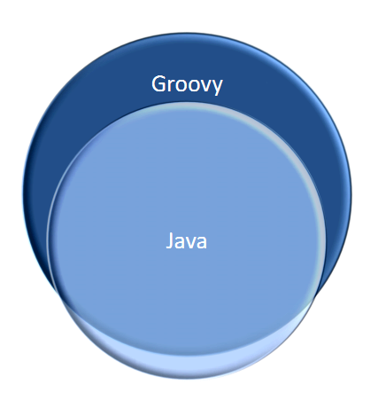
Groovy …
Is a superset of Java
  Makes interop easy
Uses Java’s Type system
Everything is an Java Object
Is Java +
  syntactic sugar
  dynamic typing
  missing features (like closures)

Slide 16
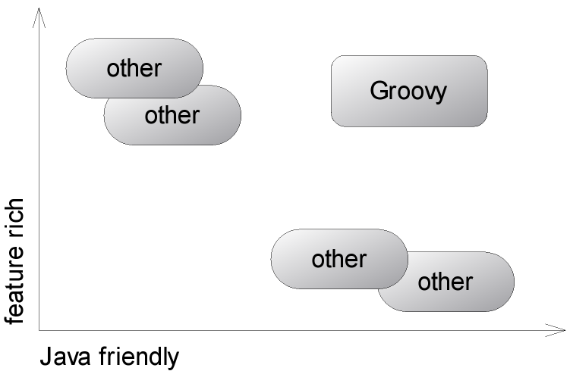
The Landscape of Java Virtual Machine (JVM™) Languages
optional types
Dynamic features call for dynamic types
Java bytecode calls for static types

Slide 17
What Groovy can do for you
Depending on your background and experience, you are probably interested in different features of Groovy.
We recognize that developers rarely have just one role within their jobs and may well have to take on each of these identities in turn.
However, it is helpful to focus on how Groovy helps in the kinds of situations typically associated with each role.

Slide 18
Groovy for Java professionals
Groovy
groovy -e "new File('.').eachFileRecurse { println it }“
Java
public class ListFiles {
public static void main(String[] args) {
new java.io.File(".").eachFileRecurse(
new FileListener() {
public void onFile (File file) {
System.out.println(file.toString());
}
}
);
}
}
Imagine Java
had this

Slide 19
Groovy for Java professionals (cont.)
Command-line availability and code beauty
Dynamic behavior to Java applications (expressing business rules, allowing smart configurations, or even implementing domain specific languages)
Using static or dynamic types
Working with pre-compiled code or plain Groovy source code with on-demand compiling
You’ll continue to work with Java technology

Slide 20
Groovy for script programmers
The Java platform has an undeniable market share
Corporate clients often run a Java standard platform (e.g. J2EE ), allowing nothing but Java to be developed and deployed in production
Groovy can move you in by providing advanced language features (to call methods on anything, pass blocks of code around for immediate or later execution, augment existing library code with your own specialized semantics)

Slide 21
Groovy for pragmatic programmers, extremos, and agilists
Step back and assess whether your “tools” are still “sharp” enough to cut smoothly
Groovy will be an invaluable tool for all automation tasks (from simple build automation, integration and reporting, up to automated documentation, shipment and installation. Supports ANT and Maven)
Makes code to be self-describing, intention-revealing.
Interplay solution - using Java for code that needs to be optimized for runtime performance, and using Groovy for code that needs to be optimized for flexibility and readability.

Slide 22
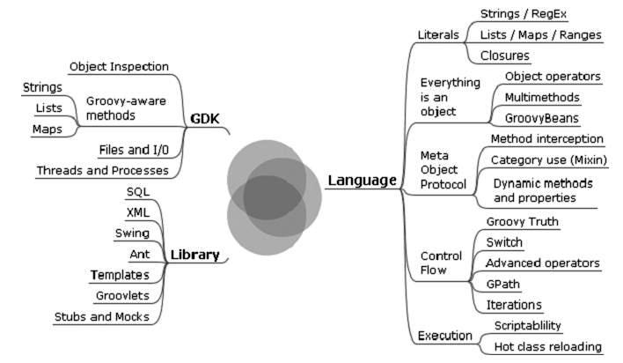
Feature-rich Language

Slide 23
Language Features
Closures, Categories and Builders
Syntax for Lists, Maps and Ranges
Java platform extensions
  IO, String, Processes
Regex Syntax
Property access (Java Beans)
XML handling
Operator Overloading
Metaprogramming

Slide 24
Java Beans
Getter and Setter syntax
  Common dotted notation (bean.property – public by default)
Getters and Setters auto-generated
Constructor syntax
  Constructs bean then calls setters
  property1: value1, property2: value2
Last line automatic return

Slide 25
JavaBeans.groovy
class Purchase {
def item
int quantity
int cost
def getTotal() {
quantity * cost
}
}
def purchase = new Purchase(item: "software", cost: 5)
purchase.quantity = 4
println "Purchased '$purchase.item' for \$$purchase.total"
Read only
property
Equivalent to:
Purchase p = new Purchase()
p.setItem(“software”)
p.setCost(5)
String templates

Slide 26
Closures
Anonymous Functions, Code Blocks
Allow Functional programming
‘Missing’ Java feature slated for Java 7, but was postponed to Java 8
Definition Syntax:
{param1, param2 ->
// Code
}
If no parameters specified, has single default parameter it

Slide 27
ClosureBasics.groovy
Closure with 2 arguments
def printSum = { a, b -> println "Sum: " + (a + b) }
printSum(5, 7)
def printDiff = { a, b -> println "Difference: " + (a - b) }
def callWithClosure(Closure closure) {
print "Closure called from method, "
closure(10, 5)
}
callWithClosure(printSum)
callWithClosure(printDiff)
callWithClosure {a, b -> println "Inline closure with $a and $b"}
Calling a Closure
Method with closure
parameter
Calling Method
with closure
Calling Method with inline closure

Slide 28
NestedClosures.groovy
Error handling closure takes
closure as a parameter
def errorHandling = { Closure c ->
try {
c()
}
catch (Exception e) {
println "Closure handled error"
e.printStackTrace()
// Can throw as another type or handle some other way throw new
// WrappedException(e)
}
finally {
// cleanup here, close resources
}
}
// Code with error handling
errorHandling {println new File("does_not_exist.txt").text }
Call the nested
closure
Common error
handling
Cleanup resources
Calling the error
handling closure

Slide 29
Strings
Single or double quoted
println "with 'single' quotes" + 'with "double" quotes'
GString - variable expansion
println "Name: $name"
Multiline String
def xml = """<?xml version="1.0"?>
<root>
<value/>
</root>"""

Slide 30
String Methods
Method | Description
"abc".reverse() | Reverses a string producing "cba"
"abc 1 2 3".split() | Splits a string on spaces producing [abc, 1, 2, 3] as an array
"1, 2, 3".tokenize(',') | Tokenizes a string on comma producing [1, 2, 3]
string.eachLine {c} | Calls the closure for each line in string
"abc"[2] | Returns the character at position 2 of the string, 'c'
"testing"[1..3] | Returns the substring between positions 1 and 3, 'est'
Range Operator

Slide 31
Lists and Collections
List Syntax
def list = [1, 2, 3]
def emptyList = []
Collection Methods
list.each { println it }
list.collect { it.action }
list.any { it == 2 }
list.every { it != 2 }
list.sort()
list.join(", ")
Overloaded Operators
list1 == list2

Slide 32
CollectionAny.groovy
def list = ["abc", "def", "ghi", "jkl"]
// Java way
boolean found = false;
for (String str: list) {
if (str.contains("z")) {
found = true;
break;
}
}
if (!found) {println "Not Found (Java)"}
//Groovy way
if (!list.any {it.contains("z")}) {
println "Not Found (Groovy)"
}
Determine if no members of
the list contain a 'z'

Slide 33
Maps
Map Syntax
def map = [a: 1, b: 2]
assert map['a'] == 1 && map.b == 2
Methods
map.each { k, v -> println "$k=$v" }
map.collect { k, v -> ... }
map = [1:'a', 2:'b', 3:'c']
def string = map.collect { k, v -> "$k:$v" }.join(', ')
assert string == '1:a, 2:b, 3:c'

Slide 34
MapsAsDynamicBeans.groovy
class Person {
String name
String address
}
def usePerson(p) {
p.name = "bob"
p.address = "123 fake street"
println "Person (${p.getClass()}) '$p.name' lives at: $p.address"
}
usePerson(new Person())
usePerson([:])
def person = [:]
person.name = "Chris"
person.address = "Planet Earth"
person.phone = "555-5326"
println person
Standard Java Bean
Code that uses bean
Using Java Bean or Map
without modification
Maps are dynamic
and extendable
Person (class Person) 'bob' lives at: 123 fake street
Person (class java.util.LinkedHashMap) 'bob' lives at: 123 fake street
[name:Chris, address:Planet Earth, phone:555-5326]

Slide 35
XML Handling
Groovy way: GPath with dynamic properties
Groovy allows classes to act as if they have properties at runtime even if the names of those properties aren’t known when the class is compiled.
GPath was built on this feature, and it allows seamless XPath-like navigation of XML documents.
Groovy has a special API to easy work with SVN

Slide 36
GPath example
customers.xml
<?xml version="1.0" ?>
<customers>
<corporate>
<customer name="Bill Gates" company="Microsoft" />
<customer name="Steve Jobs" company="Apple" />
<customer name="Jonathan Schwartz" company="Sun" />
</corporate>
<consumer>
<customer name="John Doe" />
<customer name="Jane Doe" />
</consumer>
</customers>

Slide 37
GPath Example
You can print out all the corporate customers with their names and companies using just the following code.
def customers = new XmlSlurper().parse(new File('customers.xml'))
for (customer in customers.corporate.customer)
{
println "${customer.@name} works for ${customer.@company}"
}

Slide 38
IO Processing
Method | Description
file.append(text/bytes/stream) | Appends the text, byte array or inputstream to the file
file.deleteDir() | Recursively deletes all files and subdirectories
dir.eachDir { ... } | Invokes the closure for each subdirectory of this directory
dir.eachFile { ... } | Invokes the closure for each files under the directory
dir.eachFileRecurse { ... } | Invokes the closure for each descendant file in the directory
file.text | Returns the entire contents of the file as a String
file << text | Writes the text to the file
file.withInputStream { ... } | Creates a new InputStream for reading the file and passes it to the closure.
file.eachLine { ... } | Iterates through the file passing each line to the closure.

Slide 39
Operators
Elvis Operator (short ternary) ?:
a != null ? a : b
a ?: b
Null-Safe traversal ?.
a == null ? null : a.someMethod()
a?.someMethod()
Collection Spread *.
parent.collect{ child -> child?.action }
parent*.action
as operator
[1, 2, 3, 4, 4] as Set
Regex Find (=~) and Match (==~)

Slide 40
Operator Overloading
Operator | Method Called | Operator | Method Called
a + b | a.plus(b) | a++ | a.next()
a - b | a.minus(b) | a-- | a.previous()
a * b | a.multiply(b) | a[b] | a.getAt(b)
a / b | a.div(b) | a[b] = c | a.putAt(b, c)
a % b | a.mod(b) | a << b | a.leftShift(b)
a | b | a.or(b) | a >> b | a.rightShift(b)
a & b | a.and(b) | switch (a) { case(b) : } | b.isCase(a)

Slide 41
Operator Overloading
Operator | Method Called
a == b | a.equals(b) or a.compareTo(b) == 0
a != b | !a.equals(b)
a <=> b | a.compareTo(b)
a > b | a.compareTo(b) > 0
a >= b | a.compareTo(b) >= 0
a < b | a.compareTo(b) < 0
a <= b | a.compareTo(b) <= 0

Slide 42
What is dynamic language?
What makes language really 'dynamic'
  execute at runtime many common behaviors that other languages might perform during compilation
  These behaviors could include extension of the program, by adding new code, by extending objects and definitions, or by modifying the type system, all during program execution.
  These behaviors can be emulated in nearly any language of sufficient complexity, but dynamic languages provide direct tools to make use of them.

Slide 43
Metaprogramming
Meta Class
  Every Class in Groovy has a MetaClass class.metaClass
  Can have per-instance MetaClass obj.metaClass
  Allows adding, overriding methods and properties
Mixins
  At runtime using class.mixin category - resolves multiple inheritance problems
Special Methods
  invokeMethod, setProperty and getProperty
  methodMissing and propertyMissing

Slide 44
Where to start Grooving?
Unit testing
Utility Scripts (line counting, svn changelog, etc.)
Filtering, scripting, rules language
New Code
GRAILS!!!!!

Slide 45
Groovy Performance
Yes, it is slower than Java
  Slow parts can be writing in Java
Slow Number Crunching
  Due to object creation overhead
Always getting faster
  Groovy 1.5 vs 1.6 vs 1.7 vs 1.8
  Java 7’s Invoke Dynamic bytecode (JSR-292)
Fast Enough

Slide 46
What is Groovy++?
Groovy++ is a statically typed extension to the Groovy programming language. Groovy++ provides high performance and compile time type checking for compiled code.
Beyond all the goodies of standard Groovy, this project adds a lot of functionality:
compile time checking of code
as fast as Java performance of compiled code
easy mixing of statically and dynamically typed code
very powerful type inference (reconstruct omitted type annotations)
tail recursion (compiler replace recursion with cheaper jump instruction )
traits (interfaces with default implementation)
extension methods (compile time categories, add methods/properties/operators to other classes)
standard library of utilities for functional programming, concurrency and distributed computing (early prototype stage)

Slide 47
Resources
Groovy – http://groovy.codehaus.org
Web Console - http://groovyconsole.appspot.com/
Groovy Documentation –
http://groovy.codehaus.org/Documentation
  GAPI - http://groovy.codehaus.org/gapi/
  GDK - http://groovy.codehaus.org/groovy-jdk/
Greclipse -http://groovy.codehaus.org/Eclipse+Plugin
Groovy in Action (Book)

Slide 48
Thank you

